Slide 1
Legacy MainFrame

Slide 2
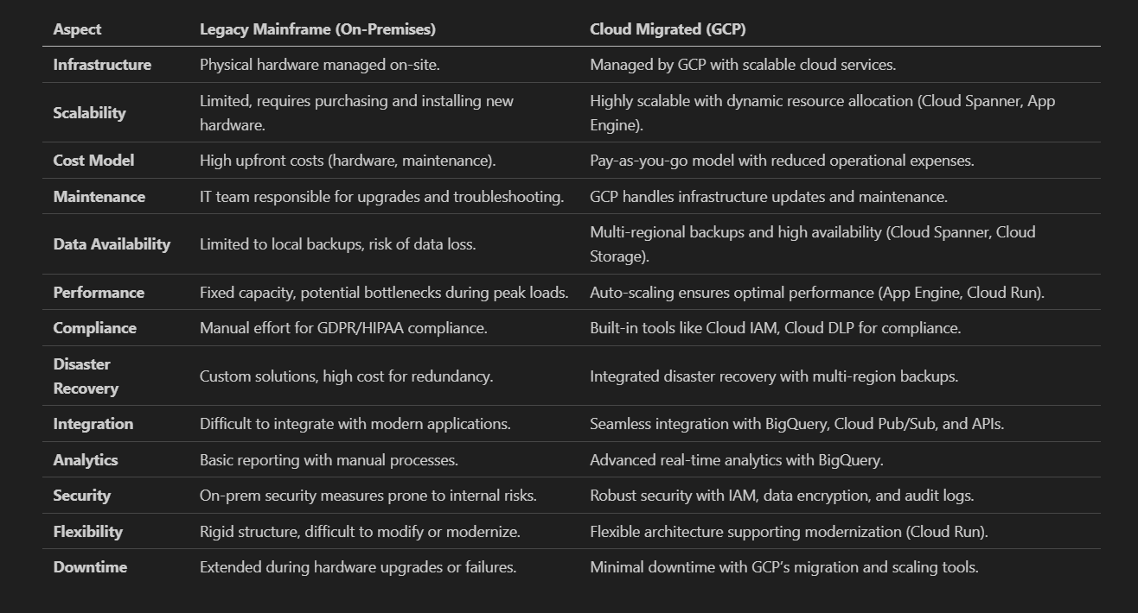
Comparison

Slide 3
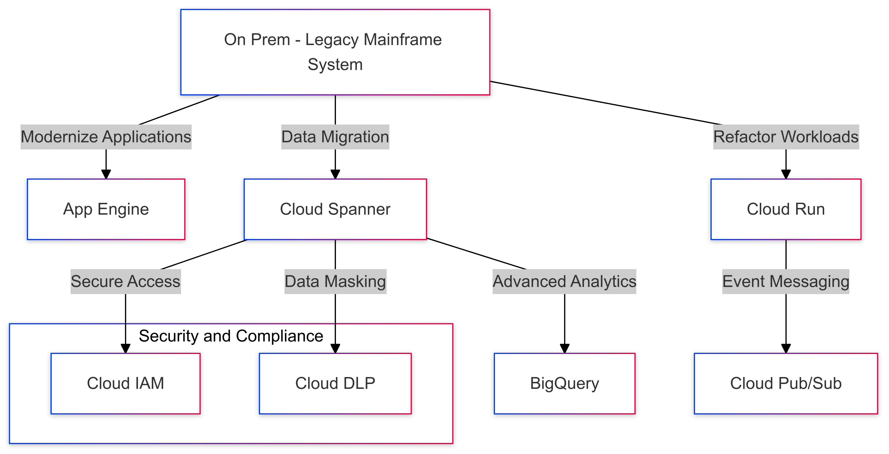
High-Level Architecture
Migration Strategy for SQL Database Cluster to Google Cloud Spanner
App Engine: Modernizes legacy applications by hosting them on a scalable, managed platform.
Cloud Spanner: Migrates and manages operational data with global scalability and consistency.
Cloud Run: Refactors workloads into containerized microservices for flexibility and efficiency.
BigQuery: Enables advanced analytics and reporting on migrated data for actionable insights.
Cloud Pub/Sub: Handles event-driven messaging for seamless integration between services.
Cloud IAM: Secures access with role-based permissions for resources and users.
Cloud DLP: Protects sensitive data by identifying and masking it during migration and processing.

Slide 4
Migration Strategy for Legacy System to Google Cloud
Assessment Phase
Inventory legacy systems and evaluate refactoring for App Engine and Cloud Run.
Preparation Phase : Set Up Cloud Services
Design workflows to refactor workloads to App Engine and Cloud Run.
Execution Phase
Start with a pilot refactoring for less critical applications.
Validation Phase
Test functionality and scalability of refactored systems on App Engine and Cloud Run.
Analyze data migration needs for Cloud Spanner.
Identify risks like downtime and compliance issues; plan mitigation.
Define KPIs for performance, uptime, and compliance.
Plan data migration workflows for Cloud Spanner.
Develop disaster recovery using multi-regional Cloud Storage.
Ensure GDPR and HIPAA compliance with Cloud DLP and IAM.
Redesign applications for App Engine and Cloud Run.
Migrate and transform data to Cloud Spanner using Database Migration Service.
Implement event-driven workflows with Cloud Pub/Sub.
Validate data accuracy and performance in Cloud Spanner.
Conduct compliance audits using IAM policies and encrypted backups.
Simulate disaster recovery scenarios and finalize stakeholder approvals.

Slide 5
Challenges Overcome with Modernization
Scalability Achieved
Dynamic Scaling:
Enhanced Disaster Recovery
Multi-Regional Redundancy:
Applications automatically scale with App Engine and Cloud Run.
Ensures cost-efficiency by allocating resources dynamically based on demand.
Global Database Support:
Cloud Spanner enables seamless growth with multi-regional capabilities.
Maintains strong consistency for global users, ensuring data accuracy.
Data is replicated across regions using Cloud Spanner and Cloud Storage.
Protects against single-region outages and ensures high availability.
Automated Backups:
Ensure quick restoration and minimize the impact of unexpected failures.
Backups are encrypted for added security.

Slide 6
Challenges Overcome with Modernization
Achieving Regulatory Compliance
Data Security:
Seamless Migration with Minimal Downtime
Live Data Synchronization:
Cloud DLP safeguards sensitive data for GDPR and HIPAA adherence.
Automatically detects and masks personally identifiable information (PII).
Access Control:
Cloud IAM enforces role-based permissions.
Integrates with multi-factor authentication for additional protection.
Database Migration Service ensures uninterrupted operations.
Synchronizes changes in real-time, minimizing migration lag.
Phased Approach:
Gradual migration reduces risks and ensures operational continuity.
Critical workloads are prioritized for early migration testing.

Slide 7
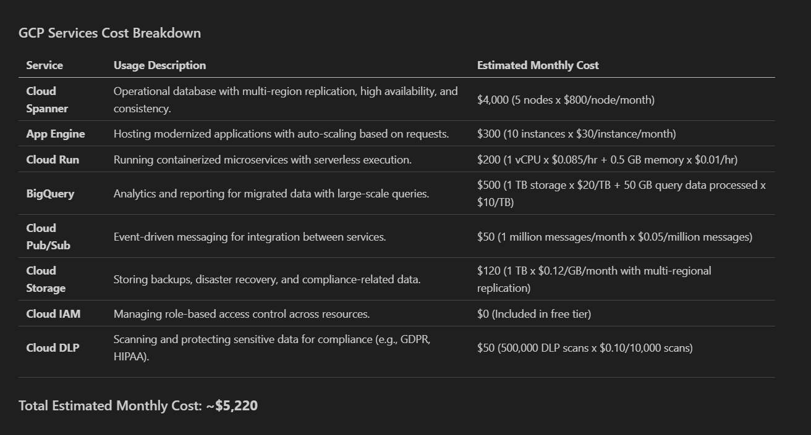
Comparison

Slide 8
Benefits
Improved Scalability and Performance
Dynamic Scaling: Auto-scaling with App Engine and Cloud Run ensures efficient handling of workloads.
Cost Optimization
Lower Costs: Eliminates expensive hardware and maintenance needs.
Simplified Compliance and Security
Regulatory Compliance: Tools like Cloud DLP and IAM simplify adherence to GDPR/HIPAA.
Enhanced Disaster Recovery
Multi-Regional Redundancy: Cloud Spanner and Cloud Storage ensure high availability.
Advanced Analytics and Insights
Real-Time Analytics: BigQuery enables faster decision-making with actionable insights.
Enhanced Performance: Modern cloud infrastructure improves response times for critical operations.
Pay-As-You-Go: Usage-based billing with Cloud Spanner and BigQuery reduces waste.
Fast Recovery: Automated backups minimize downtime during failures.
Enhanced Security: Data encryption and Cloud Audit Logs provide robust data protection.
Improved Reporting: Consolidated data supports better strategic planning.

